Slide 1
INVESTIGATING MACHINE LEARNING METHODS FOR HUMAN BEHAVIOUR ACTIVITY WITH DEPLOYMENT
by
Khrishawn Randal Samuel Powell
Supervisor: Dr SS Fatima
Department of Computer Science
Loughborough University
Notes:
‹

Slide 2
Problem
Many old people live alone, and this number is set to increase.
When old people live alone, they sometimes find it hard to carry out traditional daily activities.
As a result, is there a way we can automate their homes to make lives easier for them?
To do this Machine Learning can be used to predict human behavior Activity.
But to do this we have to investigate what Machine Learning models are the best to carry this out

Slide 3
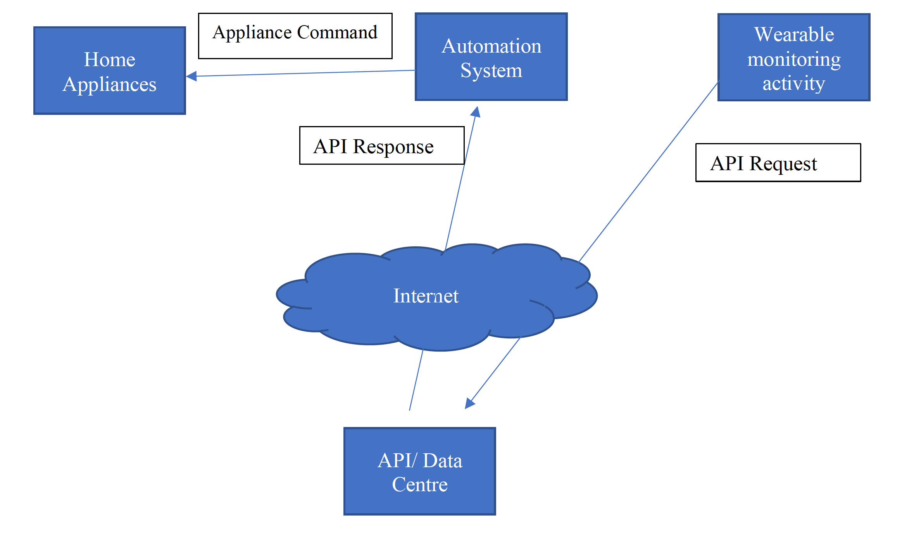
Solution

Slide 4
What was done during this project
Data Exploration
Data Visualisation
Data Training using Train Test Split
Data Training using K Fold Cross- Validation
Hyperparameter Tuning
Evaluation of Models
Deployment

Slide 5
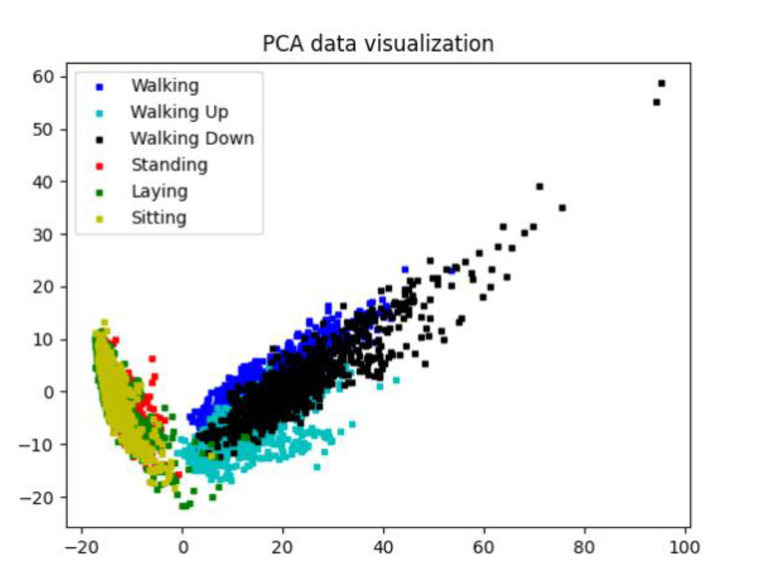
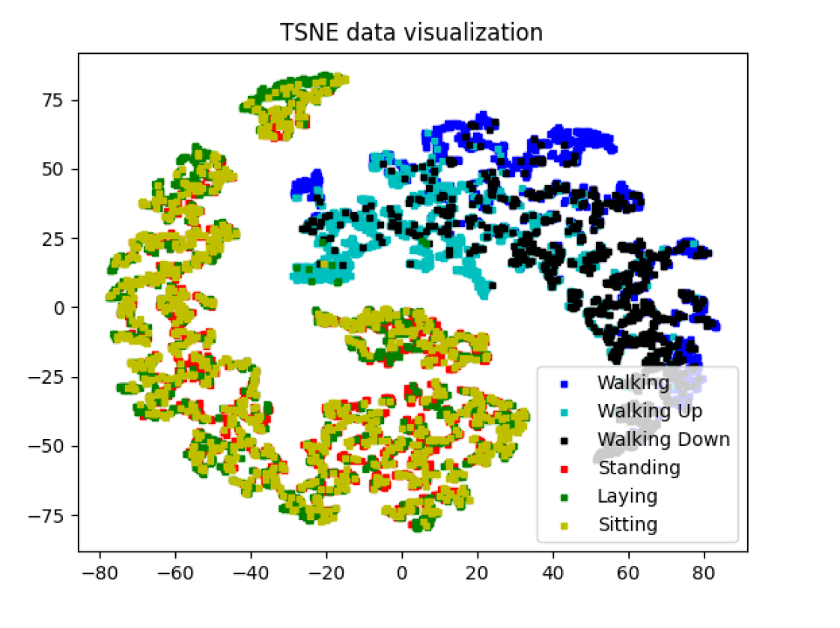
Data Visualisation

Slide 6
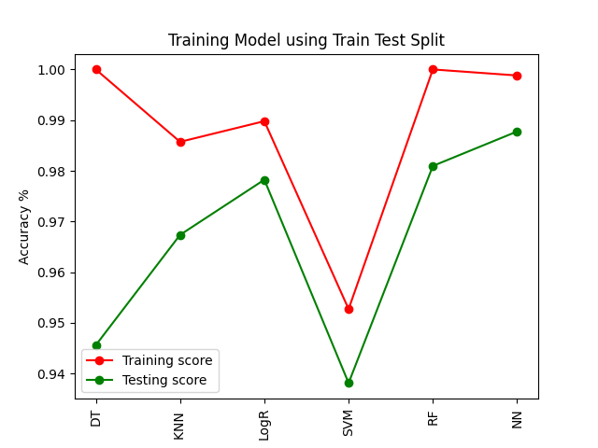
Train Test Split
Train Test Split works by:
Data is trained and tested based on the percentage specified. test_size = 0.2 means 20% of the dataset will be the test size and 80% will be used for training.
Top 3 Training Scores
Position | Model | Score
1st | Decision Tree | 100%
2nd | Random Forest | 100%
3rd | Neural Network | 99.8%
Top 3 Test Scores
Position | Model | Score
1st | Neural Network | 98.78%
2nd | Random Forest | 98.10%
3rd | Logistic Regression | 97.82%
BUT ARE THESE ACTUALLY ENOUGH PROOF?

Slide 7
What is K - Fold Cross Validation
How does K - Fold Cross validation work?
The data is split into K - Folds .
E.g. if K is 5 data will be split into 5 folds
From each Split 1-fold is used to test the model and K-1 folds are used to train the model .
During each split, the test sets is changed, and a new set of K-1 folds are used.
The mean of all test scores are calculated and the final accuracy score is the mean of all test scores.
Benefits
Every data instance has the ability to appear in the training and testing set and as a result of this gives us much fairer reliable results.

Slide 8
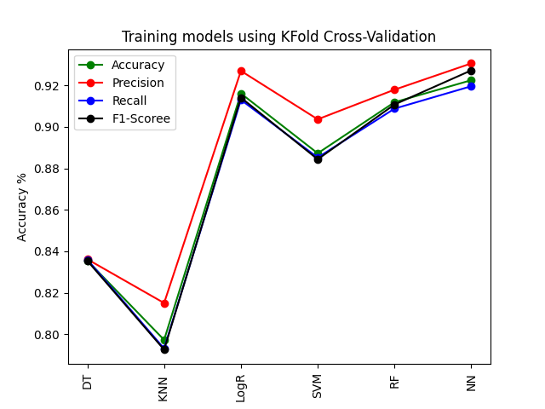
K - Fold Cross-Validation
Top 3 Training Scores
Position | Model | Score
1st | Neural Network | 92.42%
2nd | Logistic Regression | 91.61%
3rd | Random Forest | 90.91%
But can we achieve better results??

Slide 9
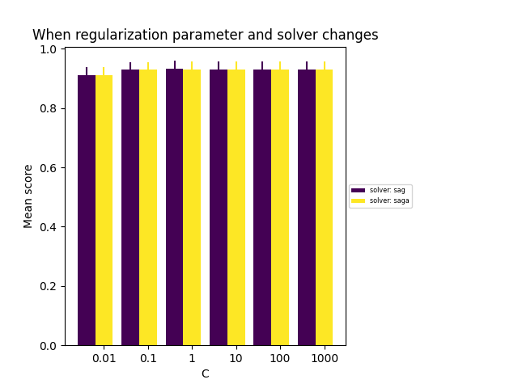
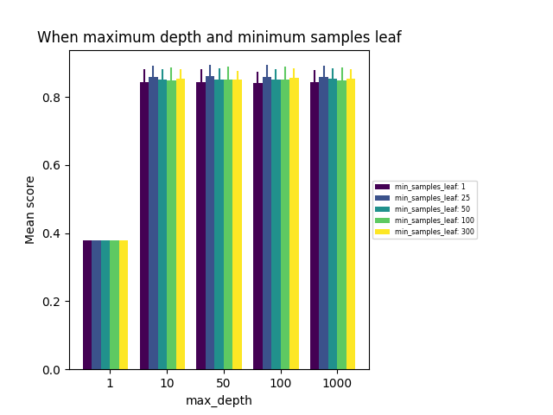
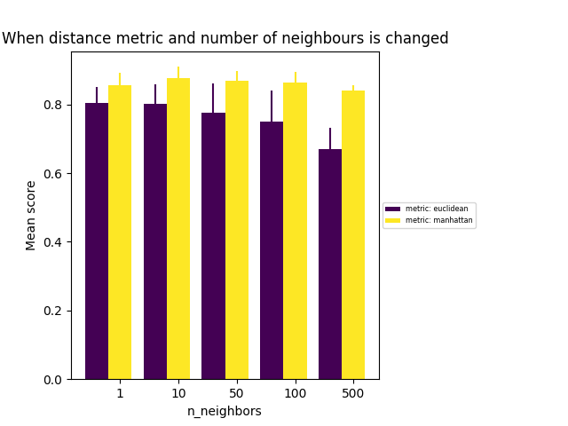
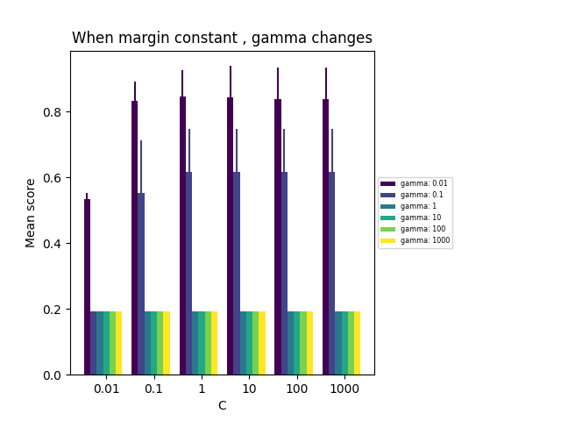
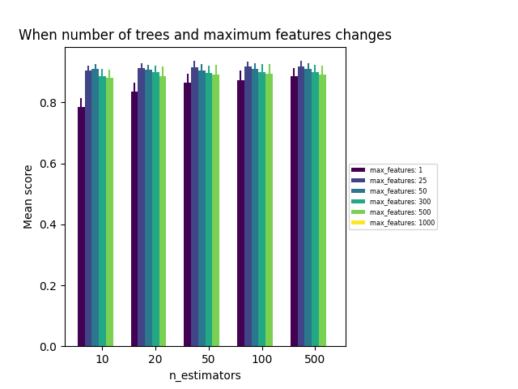
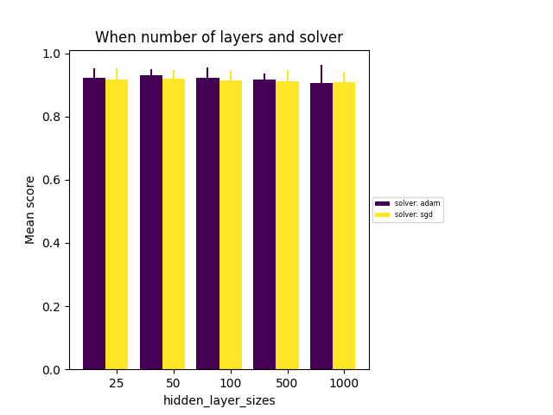
Hyperparameter Tuning
Logistic Regression
Decision Tree
K Nearest Neighbour
Support Vector Machine
Random Forest
Neural Networks
Notes:
More info in Chapter 6

Slide 10
Getting Better
Before Hyperparameter tuning
Position | Model | Score
1st | Neural Network | 92.42%
2nd | Logistic Regression | 91.61%
3rd | Random Forest | 90.91%
After Hyperparameter tuning
Position | Model | Score
1st | Logistic Regression | 93.1999
2nd | Neural Network | 93.10
3rd | Random Forest | 91.774

Slide 11
Evaluation on Test Set
Evaluating parameters on test data
Model | Training Score | Testing Score
Decision Tree | 95.28% | 84.56%
K- Nearest Neighbour | 98.71% | 91.11%
Logistic Regression | 99.07% | 95.66%
Support Vector Machine | 98.93% | 93.07%
Random Forest | 100% | 92.80%
Neural Network | 99.31% | 93.79%

Slide 12

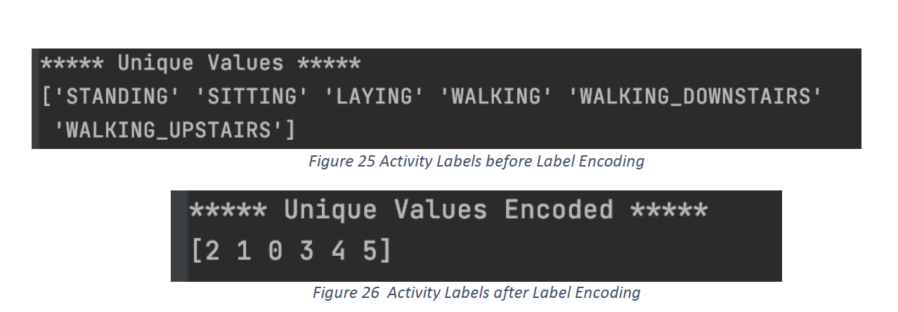
Can we possibly deploy the model to be able to predict human behaviour activity in real time?

